Slide 1
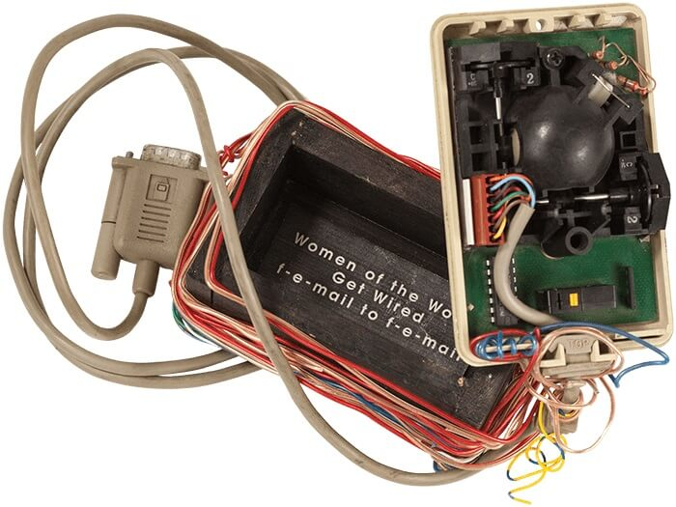
Iniciativas de Mujeres en Arte y Tecnología
Un mapeo internacional de todas las prácticas de asociacionismo y autogestion colectiva desde 1986
Wired F-e-mail, Victoria Vesna, 1995. In the body of the piece we read: “Women of the World, Get Wired f-e-mail to f-e-mail”.
Elena Robles Mateo. 2020

Slide 2

MAPEO INTERNACIONAL
www.atenea.in/research

Slide 3

RESULTADOS
01
02
INICIATIVAS AUTORGANIZADAS Y AUTOGESTIONADAS
INICIATIVAS NACIDAS DESDE LA INSTITUCIÓN
03
04
ORÍGENES:
ESPACIOS Y GRUPOS DE MUJERES ARTISTAS
PRIMERAS PRÁCTICAS CURATORIALES DE MUJERES EN ARTE COMPUTACIONAL

Slide 4

CONCEPCIONES HISTÓRICAS
CIBERFEMINISMO
ESTADOS UNIDOS COMO CENTRO Y ORÍGEN
ESPACIOS DE MUJERES EN LA SEGUNDA OLA DEL FEMINISMO

Slide 5

GRUPOS DE
MUJERES ARTISTAS ANTES DEL S.XX
“The only way for a woman, as for a man,
to find herself, to know herself as a person, is by creative work of her own.”
Betty Friedan in
The Feminine Mystique, 1963

Slide 6

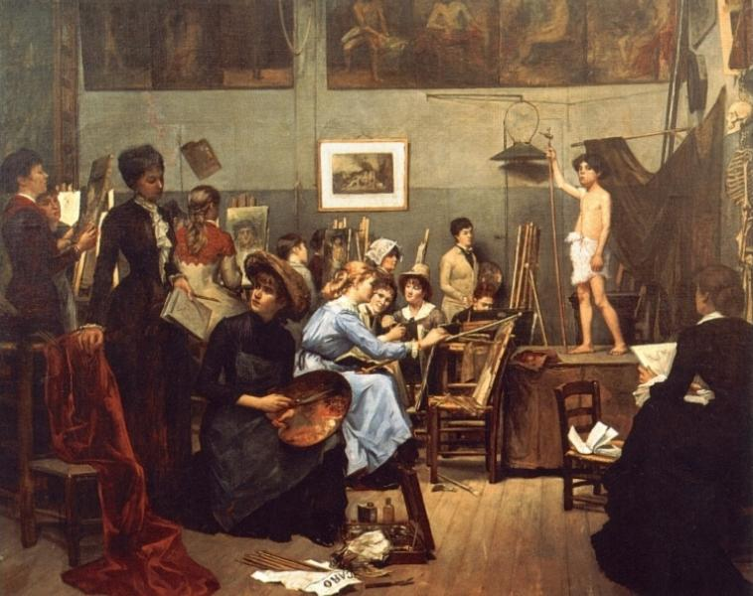
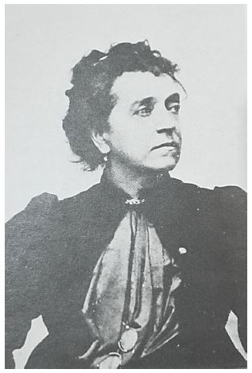
TABLE
Dans l’atelier (1881); Marie Bashkirtseff. Piece currently exhibited in the Dnipropetrovsk State Art Museum
Anonyme-1889-Madame Léon Bertaux (1825-1909)

Slide 7
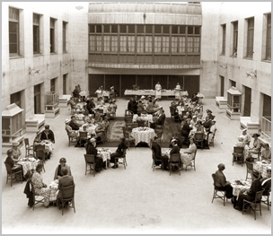
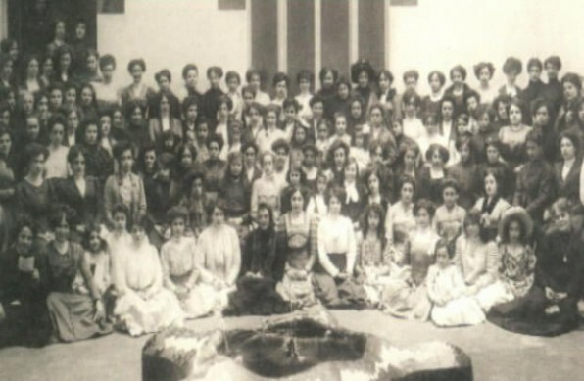
BIBLIPTECA POPULAR DE LA DONA, 1909
Image of the students of Biblioteca Popular de la Dona circa 1914. Source: Beteve.cat

Slide 8
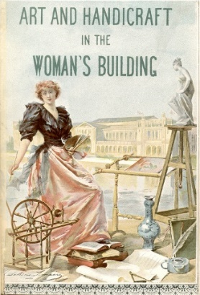
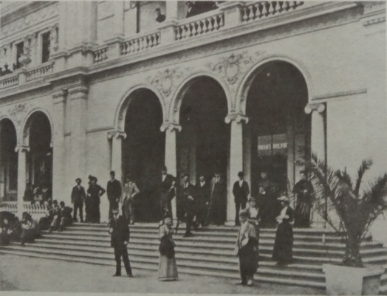
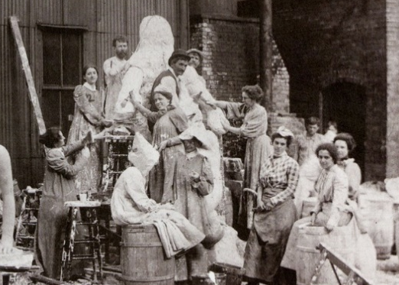
PRIMERA EXPOSICIÓN INTERNACIONAL
THE WOMAN’S BUILDING, 1893
Lorado Taft and several of his female students at work, known as The White Rabbits, circa 1899
The Woman's Building. World's Columbian Exposition, Chicago, 1893. Retrieved from Navarreta, 1982.
Picture Madeleine Lemaire's poster for poster for The Art & Handicraft in the Woman's Building

Slide 9
ESPACIOS DE
MUJERES ARTISTAS S.XX
“As a woman, I have no country. As a woman, my country is my world.”
—
“A woman must have money and a room of her own if she is to write fiction.”
Virginia Woolf (1929)

Slide 10
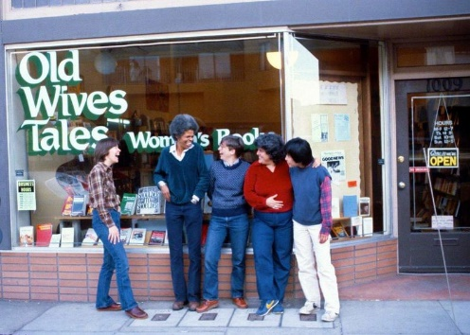
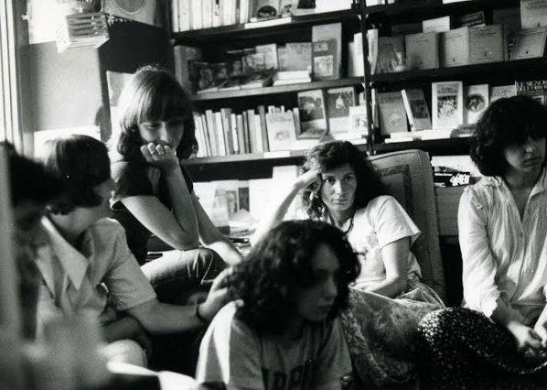
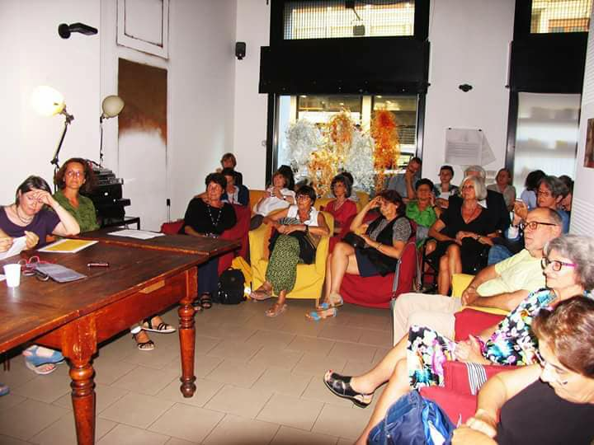
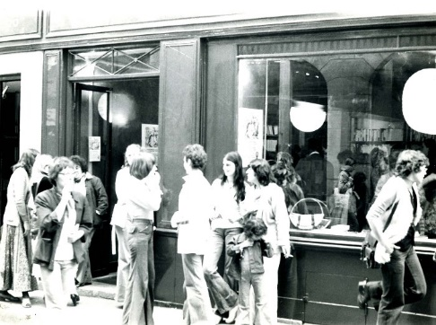
LIBRERÍAS FEMINISTAS
Old Wives’ Tales in Valencia 16 Calle San Francisco founder Carol Seajav’s. Opened from 1976 to 1995. Source: www.foundsf.org
Librerie delle Done in Milan, active with platform, providing resources, creating meetings, social networks, blog, art. Left: circa 1974, Right: photo from 2017. Source: www.libreriadelledonne.it
Librairie Des femmes founded in 1974 in Paris. Source: www.librairie-des-femmes.fr

Slide 11
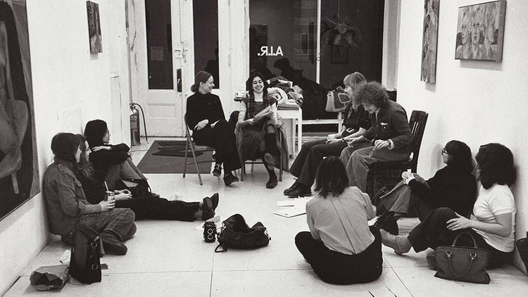
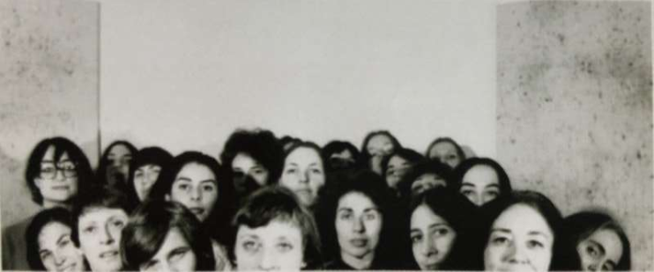
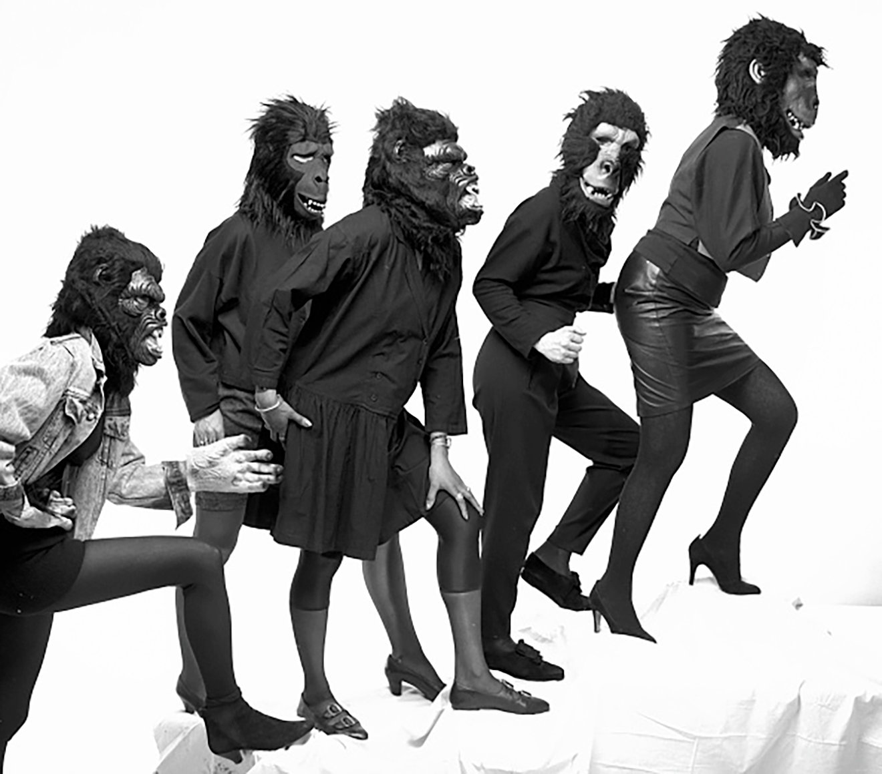
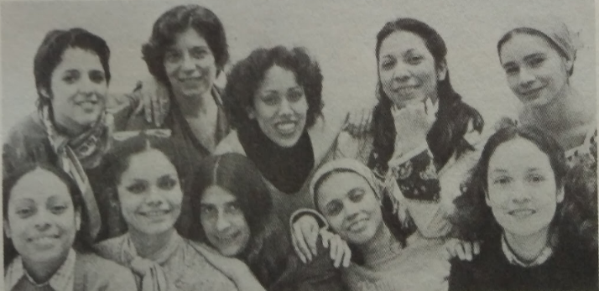
ESPACIOS ALTERNATIVOS DE ARTE
A.I.R's first gallery on 97 Wooster Street, 1974.
Retrieved from www.airgallery.com
SOHO20 members in 1976, photo credit: John Waggaman / SOHO20 archive
Las Guerrilla Girls formed in 1985 in New York City
Las Comadres, New York. Photo by Nydza Bajandas. Retrieved from Navarreta, 1982.

Slide 12
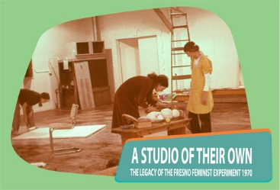
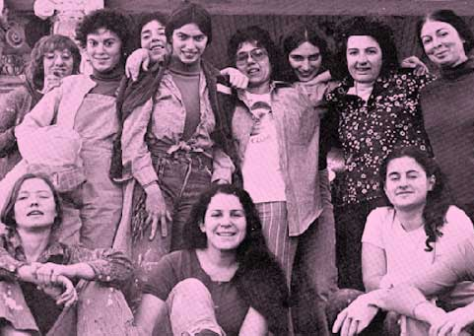
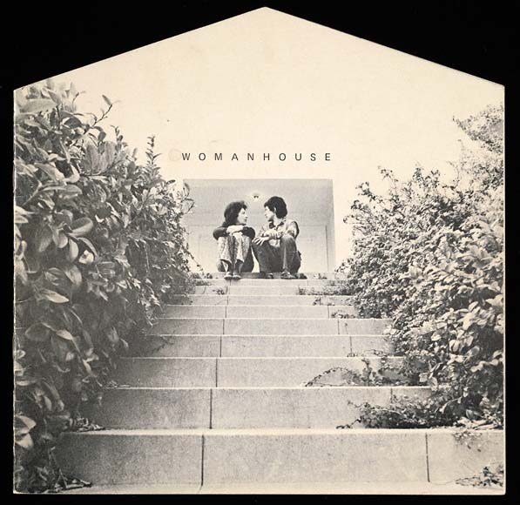
CURSOS DE ARTE FEMINISTA 1970s
FRESNO ART PROGRAM & WOMANHOUSE
Woman House students 1972, available at http://home.refugia.net/portfolio/womanhouse
Detail from Members of the Fresno Feminist Art Programme at work in the feminist studio, 1970. Photograph by Dori Atlantis.
Womanhouse catalogue, Feminist Art Programme at CalArts, 1972. Designed by Sheila Levrant de Bretteville. The Getty Research

Slide 13
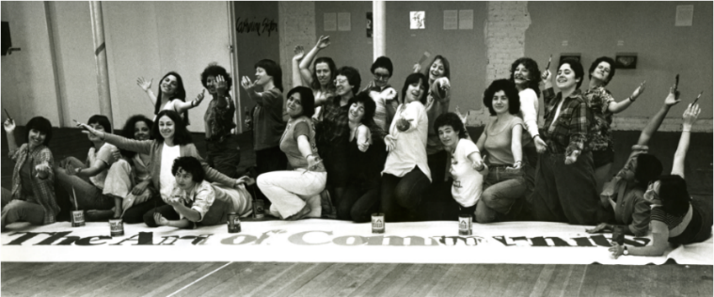
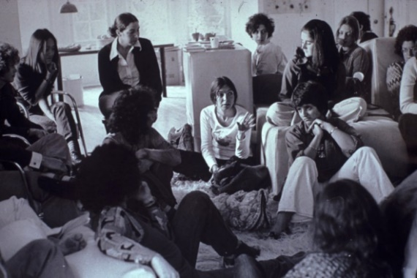
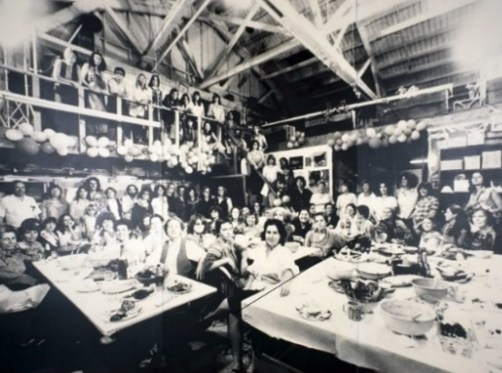
FEMINIST STUDIO WORKSHOP & THE WOMAN’S BUILDING 1973
The Art of Community, The Woman’s Building Class, Copyright © the Woman's Building, 2016
Judy Chicago’s 39th birthday dinner in The Dinner Party Studio. Source: https://judychicagocollaboration.org
Feminist Studio Workshop in 1973, from “!Women Art Revolution”. Credit: Sheila Levrant de Bretteville / Zeitgeist Films

Slide 14
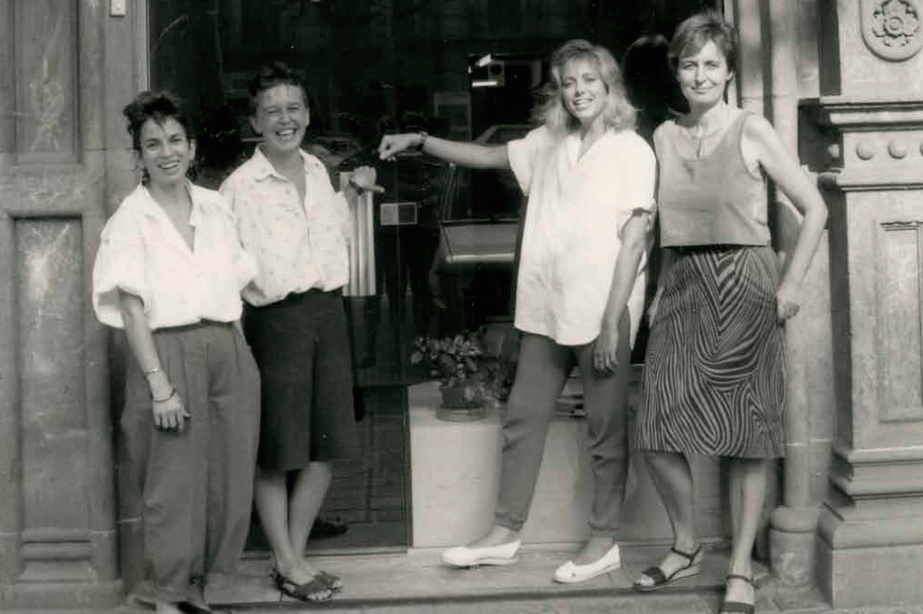
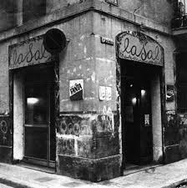
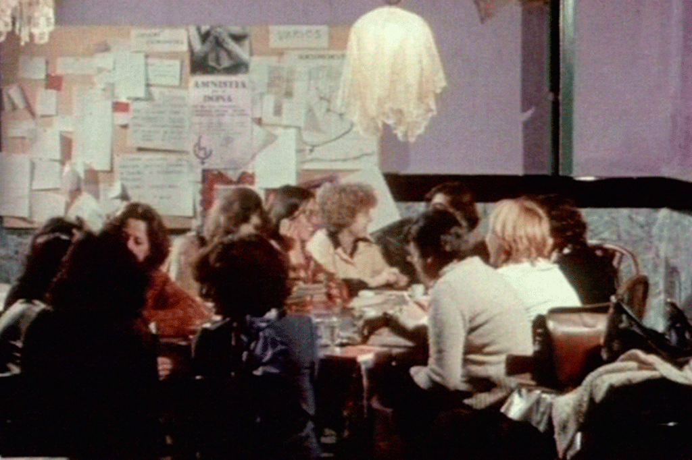
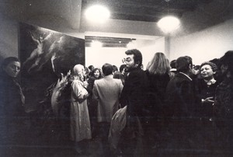
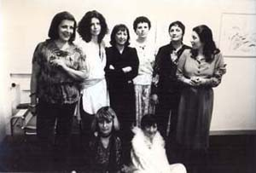
ESPACIOS DE MUJERES EN EUROPA
laSal was a women’s space for art, Reading circles, meetings, and founded a press editorial itself. Photos circa 1976. Retrieved from http://tiny.cc/eb64iz
Figure 21 Members from the Cooperativa Beato Angelico opening party at Eva Menzio;s place. Aprile 1976.

Slide 15
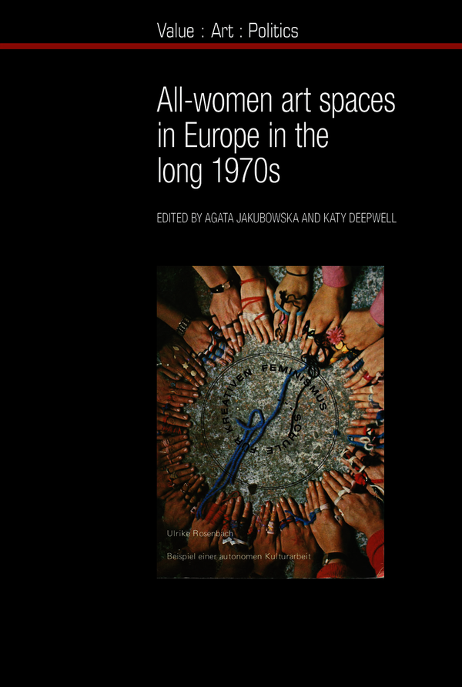
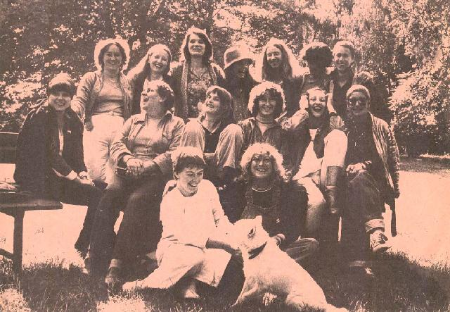
GRUPOS Y ESPACIOS DE MUJERES ARTISTAS EN EUROPA EN LOS 70
Image of InAkt [Internationale Aktionsgemeinschaft Bildender Künstlerinnen] Vienna, 1983.
All-women Art Spaces in Europe in the Long 1970s
by Agata Jakubowska (Editor), Katy Deepwell (Editor)

Slide 16
MUJERES EN LA HISTORIA DEL ARTE COMPUTACIONAL

Slide 17
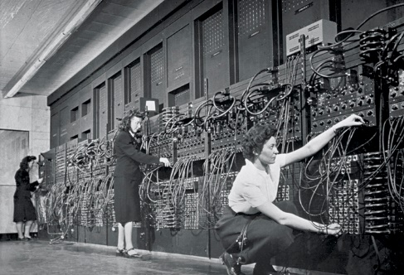
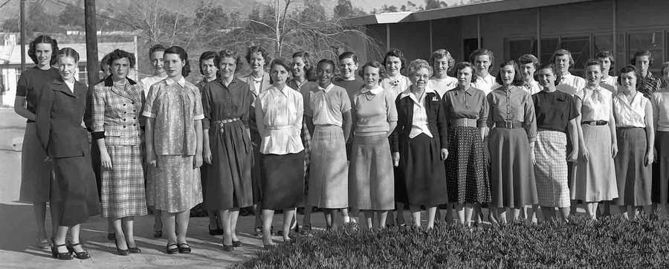
PRIMERAS MUJERES PROGRAMADORAS
Marylin Wescoff and Ruth Lichterman, two of the programmemers in the switchboard of ENIAC
Groups of computers at NACA (in 1958 NASA), circa 1935, in charge of satellite trajectory calculation and others.

Slide 18
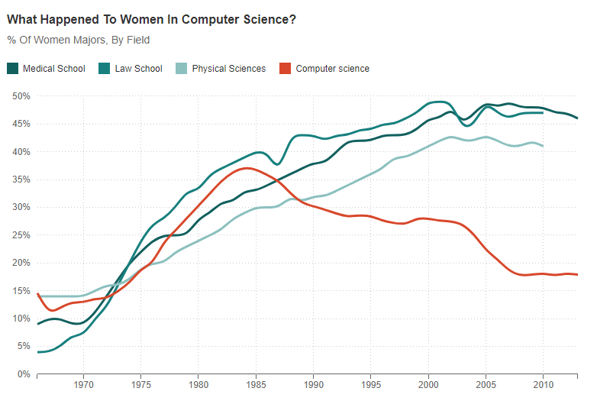
Caída mujeres en ciencias computacionales en los 1980s
“What happened to Women in Computer Science in United States?” Source: National Science Foundation, American Bar Association, American Association of Medical Colleges. Credit: Quoctrung Bui/NPR. Data United States of America

Slide 19
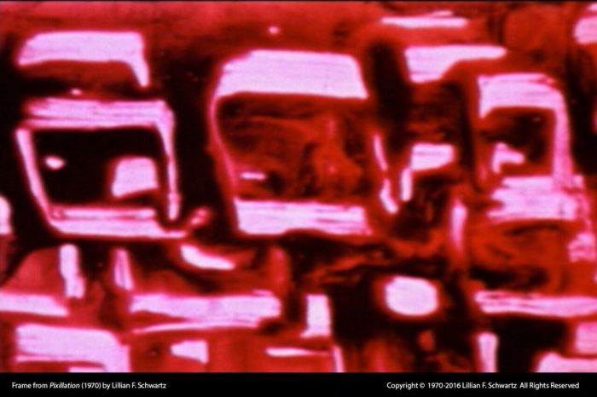
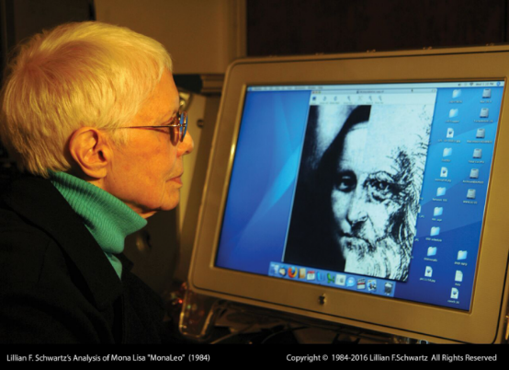
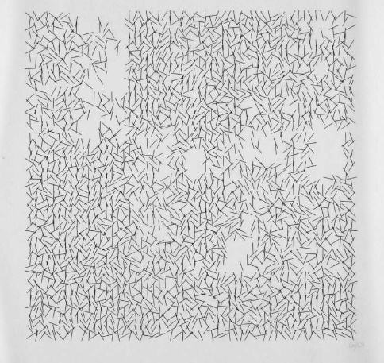
PRIMERAS MUJERES ARTISTAS COMPUTACIONALES
The computer artist Lillian Schwartz’s Analysis of Mona Lisa “MonaLeo” 1984
Frame of Pixillation a four-minute film by Lillian Schwarz 1970 commissioned by AT&T Bell Laboratories.
Interruptions (1969) by Vera Molnar is a plotter drawing. The image was made by a pen attached to a computer-controlled drawing machine – in this instance an IBM 370 with an IBM 2250 cathode ray tube (CRT) monitor and plotter

Slide 20
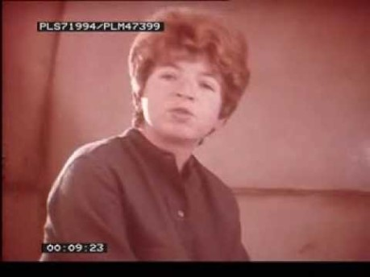
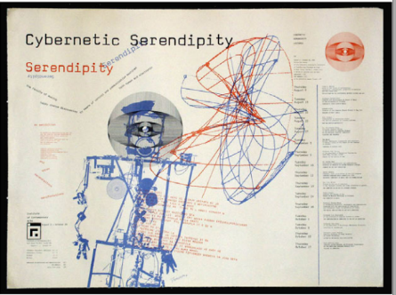
TABLE
Figure 34 Invitation to Cybernetic Serendipity. 1968
Jasia Reichardt presenting Cybernetic Serendipity, 1968, London. Fragment of the video, retrieved from www.youtube.com/watch?v=n8TJx8n9UsA

Slide 21
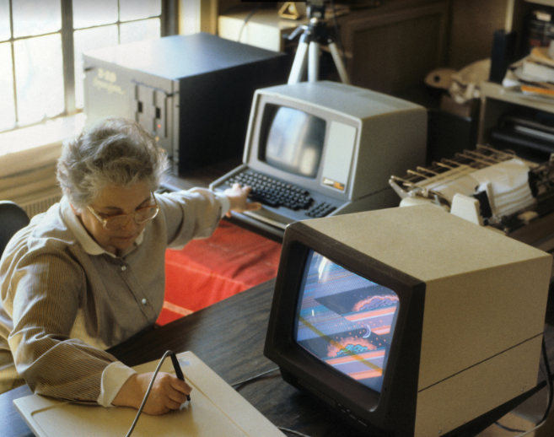
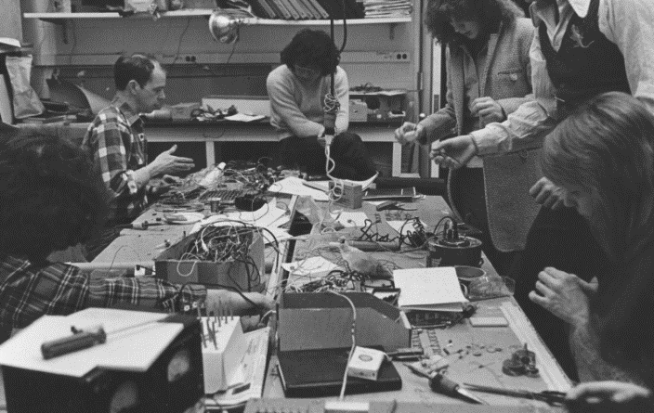
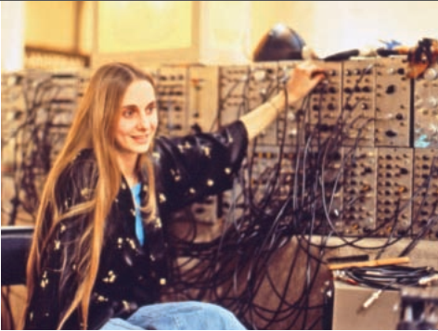
TABLE
Sonia Sheridan manipulating the Cromemco Z-2D system with EASEL software, 1982. Courtesy The Daniel Langlois Foundation for Art, Science, and Technology, Sonia Landy Sheridan fonds.
Figure 38 Steve Waldeck teaching electronics and kinetics to his female and male students at the School of Art Institute of Chicago, late 1970s, in ats@50, 2019
Barbara Sykes jamming and performing on the image processor during “Environmental Symmetry,” 1977, a day-long multimonitor, interactive performance environment that included audience participation, dancers, and musicians. Courtesy of Barbara Sykes

Slide 22
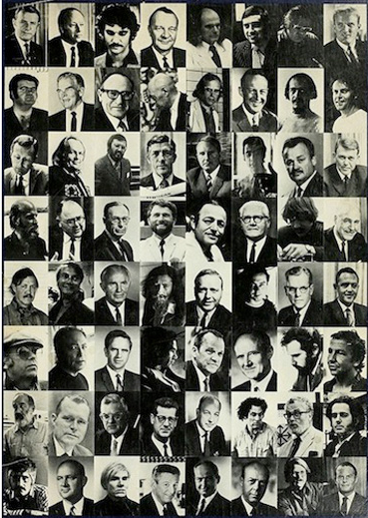
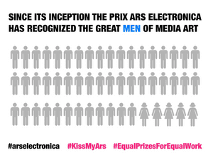
CUATRO DÉCADAS DESPUÉS…
Campaña #kissmyars 2016 Linz
Art and Technology Poster, 1971, LACMA, Los Angeles.

Slide 23
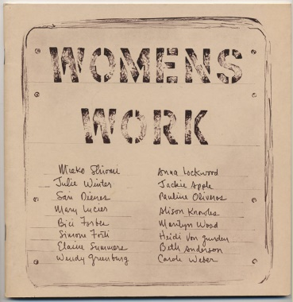
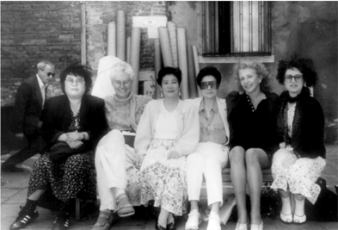
MUJERES EN FLUXUS
Anna Lockwood et al. Women’s Work (self-published, 1975)
From left: Shigeko Kubota, Alison Knowles, Mieko Shiomi, Yoko Ono, Carolee Schneemann, and Sara Seagull, at the Fluxus exhibition ‘‘Ubi Fluxus, Ibi Motus’’

Slide 24
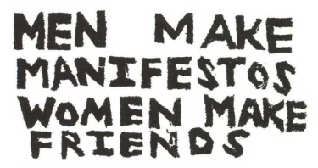
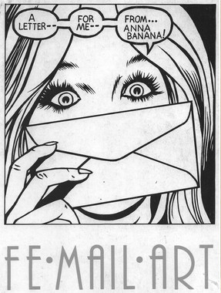
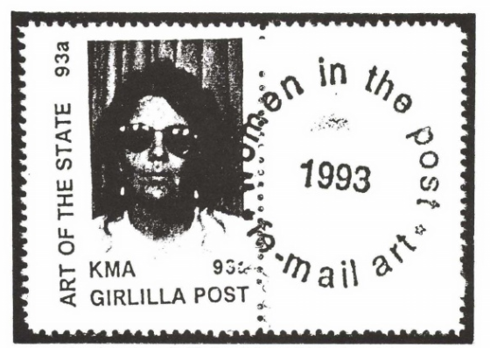
REDES DE MUJERES EN ARTE POSTAL
Freya Zabitsky, Men Make Manifestos, U.S.A., 1987(?). Handcarved Rubber Stamp. Retrieved from Friedman, 1995.
Pat Larter, rubberstamps. Letter to Lomholt 1978-11-19. Envelope. Pat and Richard Larter, Australia
Beth Jacobson, Girlilla Post, USA, 1994, Handcanceled Artists’ Stamp.

Slide 25
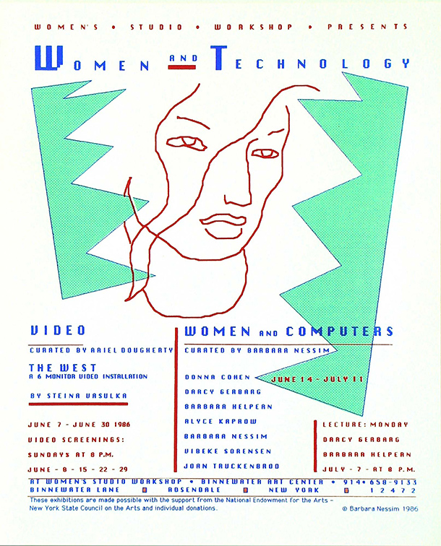
PRIMERA EXPOSICIÓN COLECTIVA DE MUJERES
Women and Technology 1986, New York
Figure 58 Women and Technology, silkscreen print, Barbara Nessim, 1986. Museum no. E.62-2013
© Victoria and Albert Museum, London/ Barbara Nessim. Retrieved from Lenz, 2014.

Slide 26
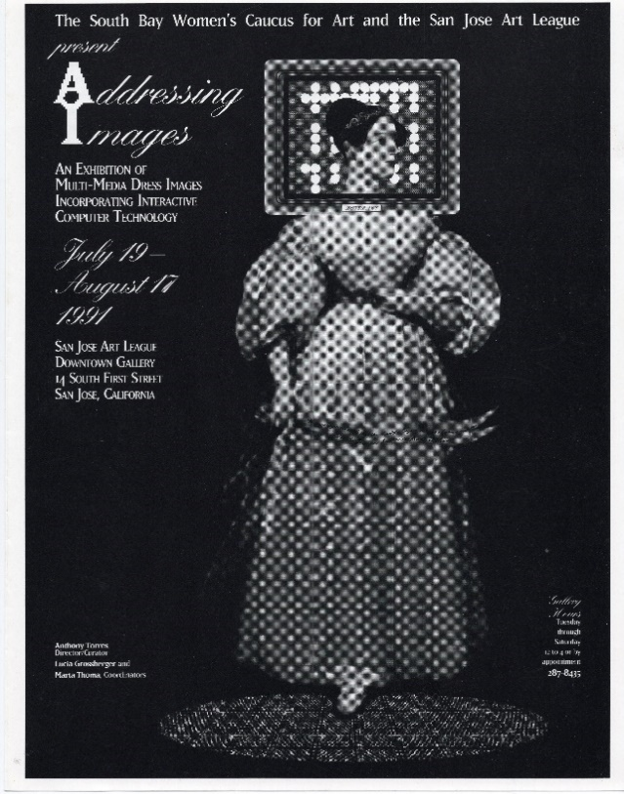
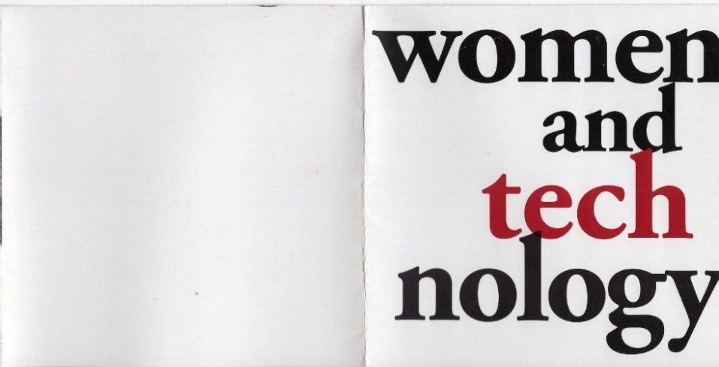
TABLE
Addressing Images, 1991 & Women and Technology SIGGRAPH L.A 1992
Catalog/invitation letter page from ‘Women and Technology’ Symposium, L.A. SIGGRAPH, 1991.
Courtesy: Lucia Grossberger.
Figure 59 Addressing Images. Exhibition poster designed by Beth Regardz and Lucia Grossberger, 1991.
Courtesy: Lucia Grossberger.

Slide 27



PRIMER PROGRAMA EN FESTIVAL
UTOPIA/DYSTOPIA, 1995 SAN FRANCISCO
UTOPIA/DYSTOPIA poster, designed by Rex Ray. San Francisco, April 1995. Courtesy of Lucia Grossberger
Figure 63 UTOPIA/DYSTOPIA poster, 1995.
Courtesy of The LAB
Figure 64 VIRTUAL FEMALE, in UTOPIA/DYSTOPIA poster, designed by Rex Ray. San Francisco, April 1995.

Slide 28


VSN - CIBERFEMINISMO
Three of VNS members posing in front of a billboard based on the Cyberfeminist Manifesto, shown on the side of Tin Sheds Gallery, Sydney, in 1992. Source: www.rhizome.org
VNS Matrix postcard, 1994. Left to Right Francesca Da Rimini, Virginia Barratt, Julianne Pierce, Josephine Starrs. Image courtesy of Virgina Barratt via Motherboard

Slide 29



TABLE
Screenshot of the main page (left) and search engine (right) of the website <http://wwol.inre.asu.edu/artists.html
Figure 67 Wollongong's World's Women Online (WWWO) curators Melinda Rackham (left) and Louise Manner, with the Home Page of WWWO displayed on screen. Louis. Source: www.ouw.edu

Slide 30



TRANSNATIONAL NETWORK
Faces Settings 1996
Face Settings, September 1996, dinner in Rotterdam, the Netherlands. Courtesy: Kathy Rae Huffman
Composition of images from the office workshop and soup pint at Ars Electronica 1997.
Face Settings image. Courtesy: Kathy Rae Huffman

Slide 31



KASSEL & OLD BOYS NETWORK IN KASSEL BIENNAL 1997
Founders. Left to right: Kathy Rae Huffman, Diana McCarty, Valie Djordjevic, circa 1997. Austria. Source: Digicult
Women artists at Hybrid Workspace in documenta X, Kassel, 1997. Courtesy: Kathy Rae Huffman.
Participants in the First Cyberfeminist International after the dinner at Hybrid WorkSpace at Documenta X, 1997. Courtesy: Kathy Rae Huffman

Slide 32




-INNEN & FRAUEN UND TECHNIK 1992-1996
Members of the collective Frauen und Technik, 1992. Courtesy: Cornelia Sollfrank
picture of -innen collective, members in blue suit. From 1994 to 1996.
pictures of -innen collective. From 1994 to 1996.
Figure 79 pictures of -innen collective From 1994 to 1996.

Slide 33





FACES: DE KASSEL A HOY: https://www.faces-l.net/
Figure 87 Participants in the First Cyberfeminist International socializing during the dinner at Hybrid WorkSpace at Documenta X, 1997. Source (left): www.rhizome.org; (middle and right) www.Faces-l.net
screenshots of the splash page, original site of Faces in 1998. Source: http://archive.Faces-l.net/en/Faceshtml.html

Slide 34





FACES TODAY

Slide 35

Mapping: www.atenea.in/research

Slide 36

GRACIAS
ELENAROBLES@ZOHOMAIL.EU

